Slide 1



Mental Health Maturity Assessment
Example Annual Progress Report
January 2024

Slide 2

Introduction
Our organisation is conducting an annual Mental Health Maturity Assessment based on the AREEA Resources and Energy Industry Workforce Mental Health Framework – the first of its kind assisting employers to build and maintain mentally healthy workplaces. This Maturity Assessment Tool helps us to identify where the organisation is at on a continuum of five different stages of mental health maturity – from ‘Essential’ through to ‘Progressive’. This allows us to benchmark ourselves in terms of current activities and capacities. In doing so, it is important to note that the maturity of an organisation is not static, but fluid. We will be moving forwards and backwards depending on how quickly and effectively we react to changing mental health pressures on their workforces. The programs, actions and initiatives we undertake will be selected based on what is practical and appropriate for our circumstances.

Slide 3
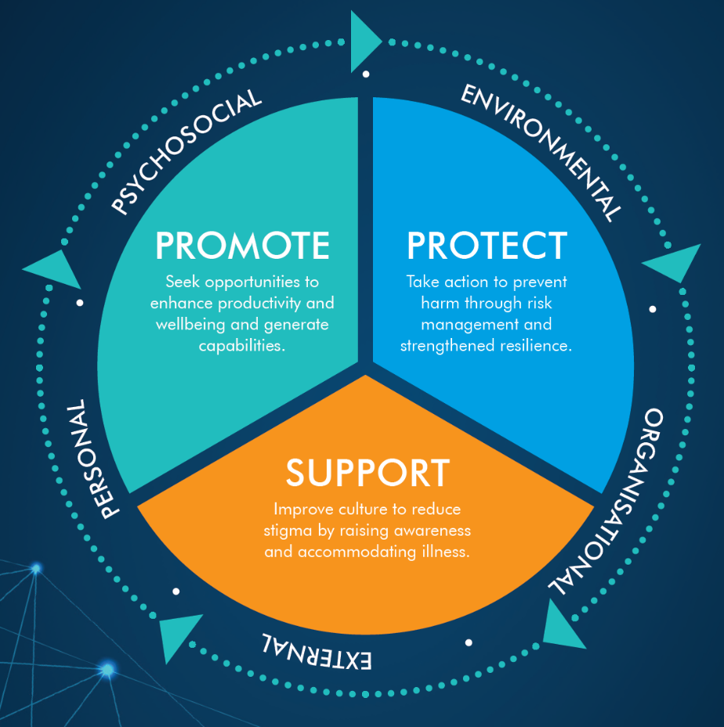
Maturity Levels | Organisation | Leaders
Essential | Recognises mental health and wellness in response to legislative requirements. | Beyond the need for compliance, mental health and wellness is not a focus.
Fundamental | Individual programs and initiatives provided but not well coordinated. | Mental Health and wellness are recognised but not a business priority.
Responsive | Programs and initiatives based on drive and passion of workforce and leaders. Little metrics or strategy alignment across work teams. | Mental wellness of employees is important but fits around other priorities.
Proactive | Is proactive and recognises benefits of a strategic approach. Policies, programs, interventions, and implementation all coordinated and aligned to metrics. | Strives to role model and lead mental health and wellness within the organisation.
Progressive | Mental health and wellness is an integral part of the workforce strategy, business planning and cultural norms. Is considered within every decision the organisation makes. Internal and external benchmarking is undertaken to maintain unrelenting focus and approach. | Recognises mental health and wellness as integral in achieving business success and organisational aspirations. Is continually evolving the organisation as a mentally healthy workplace and realising the benefits associated with a culture that accepts, supports, and enables its people.
Definitions

Slide 4
Framework
 | Essential | Fundamental | Responsive | Proactive | Progressive
PROMOTE | Mental health strategy / action plan | Standard mental health agenda item for pre-start / team meetings | Drug and alcohol campaigns | Diversity and inclusion programs and initiatives | Mental Health research
 | Policy and leadership commitment | Awareness campaigns / days of recognition | Mental health and wellbeing surveys | Mental health working group / committee | Mental health resources
 | Leadership training | Community programs / events | Learning and development | Sleep health / fatigue management | Mindfulness programs
 | Consultation and communication | Employee check-ins | Information packages | Webinars, podcasts, apps and story sharing | Lifestyle programs
 | Work design | Engagement / pulse surveys | Physical health and wellbeing programs / initiatives | Mental health campaigns and partnerships | Social and recreational activities
PROTECT | Risk management system (incl risk assessment) | Mental health and wellbeing policies | Health screenings | Manager / supervisor mental health training | Internal mental health benchmarking
 | Psychosocial hazard and incident reporting and response | Policies and procedures | Policies for accompanied, safe and dignified return to home from site | Mental health first aid training | External mental health benchmarking
 | Risk and incident management training | General mental health training / inclusion in inductions | Organisational wellbeing metrics | Organisational transparency | Suicide prevention programs
 | Specific behavioural and systemic risks | Suicide and crisis awareness training | Effective health management | Psychological safety in WHS processes | Continuous improvement program
SUPPORT | Return to work / injury management processes | Special leave provisions | Early intervention strategies / processes | Employee support networks | Access to allied health professionals
 | Review and audit | Workplace adjustments and stay at work management options | Support provided regardless of cause | Manager / supervisor contact if away from work | Resilience and coping programs
 | Employee Assistance Program (EAP) and other support programs | Stigma reduction | Flexible work arrangements | Peer support programs | Workforce and family care packages

Slide 5
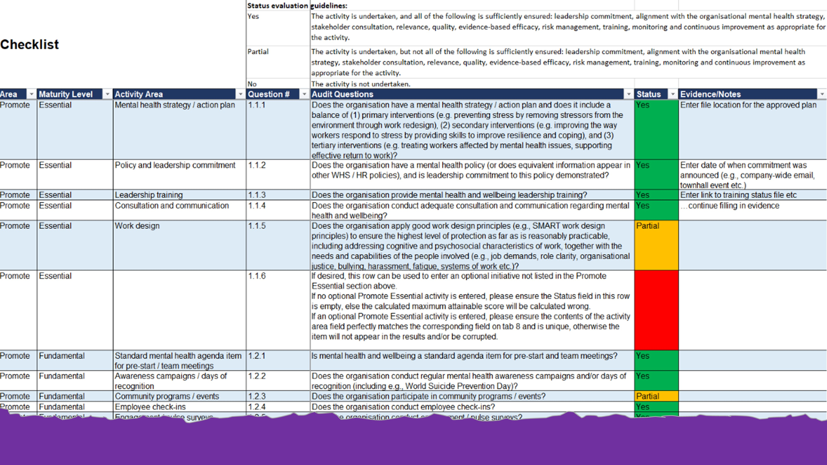
Audit Checklist
The audit checklist covers the three foundations of the framework: Promote: 28 core themes and 5 optional custom items Protect 22 core themes and 5 optional custom items Support 20 core themes and 5 optional custom items
Figure: Excerpt from sample checklist. For illustration only.

Slide 6

Results: Maturity Scores 2023 (YTD-2)
Legend:
0-33%
34-66%
67-99%
100%

Slide 7
Results: Maturity Scores 2022 (YTD-1)
Legend:
0-33%
34-66%
67-99%
100%

Slide 8
Results: Maturity Scores 2021 (YTD-2)
Legend:
0-33%
34-66%
67-99%
100%

Slide 9

Results: Maturity Dashboard 2023 (YTD)

Slide 10
Results: Maturity Dashboard 2022 (YTD-1)

Slide 11
Results: Maturity Dashboard 2021 (YTD-2)

Slide 12

Results: Heat Map 2023 (YTD)
Legend:
0-33%
34-66%
67-99%
100%

Slide 13
Results: Heat Map 2022 (YTD-1)
Legend:
0-33%
34-66%
67-99%
100%

Slide 14
Results: Heat Map 2021 (YTD-2)
Legend:
0-33%
34-66%
67-99%
100%

Slide 15

Historical Results - Charts

Slide 16


Thank you

